Slide 1
Bahmni Hands On
Hemanth S. R
Vinay Venu

Slide 2
Agenda
Basic architecture
Implementation at a high level
Customizations

Slide 3
Prerequisites
Laptop
Text editor with sftp capability
ssh client (putty.exe for Windows)
Using the linux command line (basic)
Basic understanding of OpenMRS and Bahmni

Slide 4
Basic architecture

Slide 5
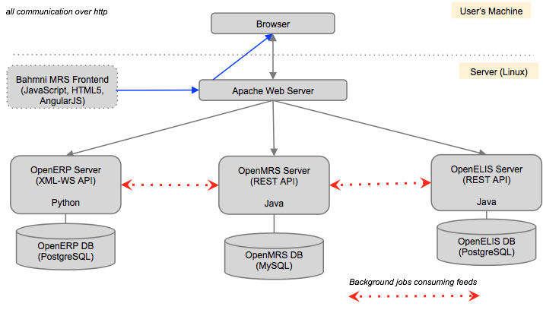

Slide 6
Of note
Native installation (CentOS for now)
Native feel (file locations and permissions, selinux, firewalls, services etc)
Multi-machine deployment made easy
Upgrades are fun

Slide 7
Implementation

Slide 8
Ensure app works
Go to https://<ip>/home (Ignore the certificate error). Login with superman/Admin123
Go to https://<ip>/openmrs. Login with superman/Admin123 or admin/test
Go to https://<ip>/openelis. Login with admin/adminADMIN!

Slide 9
Browse the system
ssh root@<ip> (Password 0penmrssummit2015)
Everything is installed as a service. Notice services openmrs, bahmni-lab and bahmni-reports. You can try service <serviceName> status to find the current status of any service.
service --status-all | grep running
All installation happens in /opt.
tree -d /opt -L 1

Slide 10
Browse the system (Contd …)
Take a deeper look at the openmrs directory
tree -d /opt/openmrs -L 1
Logs are available in /var/log
tree -d /var/log -L 1
The static content - html, css, javascript and configurations are served statically, not via an OpenMRS module.
tree -d /var/www -L 1

Slide 11
Browse the system (Contd …)
The bahmni_config directory is interesting because that is where most of the bahmni specific configurations go.
ls -l /var/www/bahmni_config/openmrs/apps

Slide 12
Customizations

Slide 13
https://github.com/HemanthGowda/Bahmni-HandsOn

Slide 14
Thank You

